Slide 1
ICE-5121: MACHINE LEARNING
Notes:
‹#›
Optimisation of the Beer Distribution Game

Slide 2
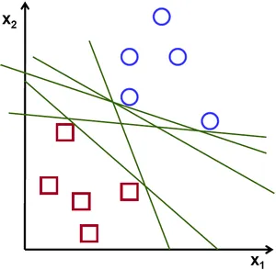
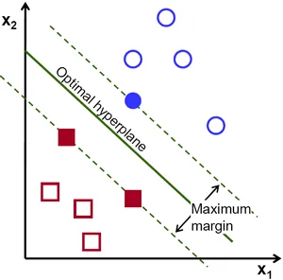
Support vector machines (SVMs)
‹#›
“Support Vector Machine” (SVM) is a supervised learning machine learning algorithm that can be used for both classification or regression challenges. However, it is mostly used in classification problems, such as text classification. In the SVM algorithm, we plot each data item as a point in n-dimensional space (where n is the number of features you have). The objective of the support vector machine algorithm is to find a hyperplane in an N-dimensional space(N — the number of features) that distinctly classifies the data points.
Notes:
Optimisation of the Beer Distribution Game
‹#›

Slide 3
Support vector machines (SVMs)
‹#›
To separate the two classes of data points, there are many possible hyperplanes that could be chosen. Our objective is to find a plane that has the maximum margin, i.e the maximum distance between data points of both classes. Maximizing the margin distance provides some reinforcement so that future data points can be classified with more confidence.
Notes:
Optimisation of the Beer Distribution Game
‹#›

Slide 4
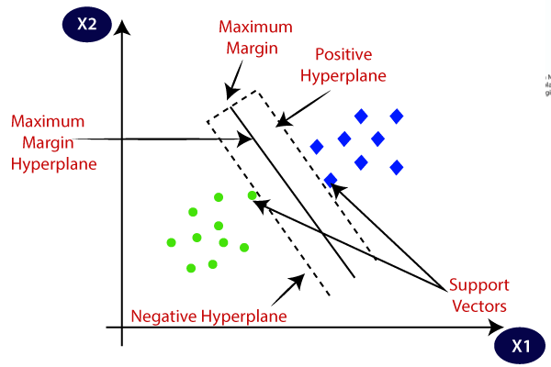
Support vector machines (SVMs)
‹#›
.
Notes:
Optimisation of the Beer Distribution Game
‹#›

Slide 5
Support vector machines (SVMs)
‹#›
The followings are important concepts in SVM:
Support Vectors − Datapoints that are closest to the hyperplane is called support vectors. Separating line will be defined with the help of these data points.
Hyperplane − As we can see in the above figure, it is a decision plane or space which is divided between a set of objects having different classes.
Margin − It may be defined as the gap between two lines on the close data points of different classes. It can be calculated as the perpendicular distance from the line to the support vectors. Large margin is considered as a good margin and small margin is considered as a bad margin.
The goal of SVM is to maximize this margin. The hyperplane with maximum margin is called the optimal hyperplane.
Notes:
Optimisation of the Beer Distribution Game
‹#›

Slide 6
Types of SVMs
‹#›
There are two different types of SVMs, each used for different things:
Linear SVM / Simple SVM: Linear SVM is used for linearly separable data, which means if a dataset can be classified into two classes by using a single straight line, then such data is termed as linearly separable data, and classifier is used called as Linear SVM classifier.
Non-linear SVM / Kernel SVM: Non-Linear SVM is used for non-linearly separated data, which means if a dataset cannot be classified by using a straight line, then such data is termed as non-linear data and classifier used is called as Non-linear SVM classifier. Example of kernel: Linear Kernel, Polynomial Kernel, Radial Basis Function (RBF) Kernel.
Notes:
Optimisation of the Beer Distribution Game
‹#›

Slide 7
Types of SVMs
‹#›
There are two different types of SVMs, each used for different things:
Linear SVM / Simple SVM: Linear SVM is used for linearly separable data, which means if a dataset can be classified into two classes by using a single straight line, then such data is termed as linearly separable data, and classifier is used called as Linear SVM classifier.
Notes:
Optimisation of the Beer Distribution Game
‹#›

Slide 8
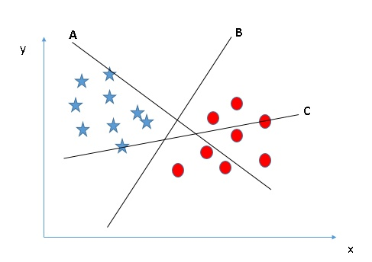
How Does a Support Vector Machine / SVM Work?
‹#›
How can we identify the right hyper-plane?
Identify the right hyper-plane (Scenario-1): Here, we have three hyper-planes (A, B, and C). Now, identify the right hyper-plane to classify stars and circles.
Notes:
Optimisation of the Beer Distribution Game
‹#›

Slide 9
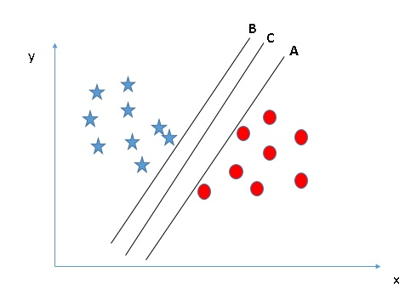
How Does a Support Vector Machine / SVM Work?
‹#›
Identify the right hyper-plane (Scenario-2): Here, we have three hyper-planes (A, B, and C), and all segregate the classes well. Now, How can we identify the right hyper-plane?
Notes:
Optimisation of the Beer Distribution Game
‹#›

Slide 10
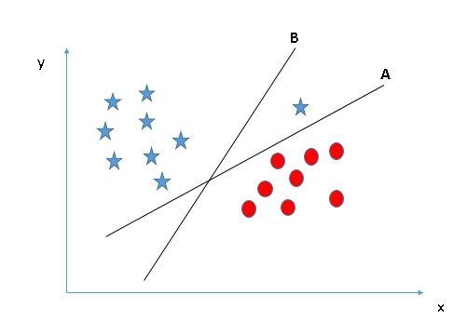
How Does a Support Vector Machine / SVM Work?
‹#›
Identify the right hyper-plane (Scenario-3):
Notes:
Optimisation of the Beer Distribution Game
‹#›

Slide 11
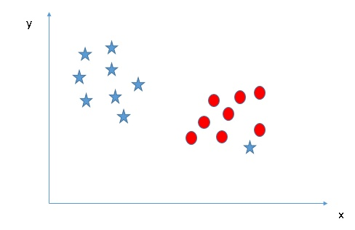
How Does a Support Vector Machine / SVM Work?
‹#›
Can we classify two classes (Scenario-4)?
Notes:
Optimisation of the Beer Distribution Game
‹#›

Slide 12
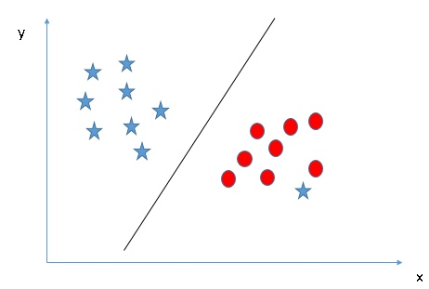
How Does a Support Vector Machine / SVM Work?
‹#›
Can we classify two classes (Scenario-4)?
Notes:
Optimisation of the Beer Distribution Game
‹#›

Slide 13
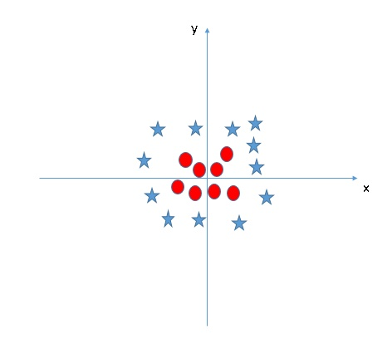
How Does a Support Vector Machine / SVM Work?
‹#›
Find the hyper-plane to segregate to classes (Scenario-5):
Notes:
Optimisation of the Beer Distribution Game
‹#›

Slide 14
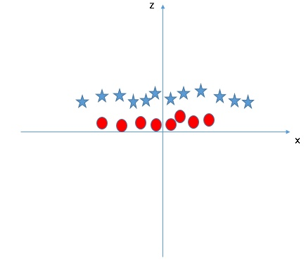
How Does a Support Vector Machine / SVM Work?
‹#›
SVM can solve this problem. Easily! It solves this problem by introducing additional features. Here, we will add a new feature, z=x^2+y^2. Now, let’s plot the data points on axis x and z:
Notes:
Optimisation of the Beer Distribution Game
‹#›

Slide 15
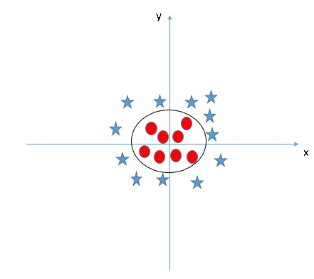
How Does a Support Vector Machine / SVM Work?
‹#›
Non-linear SVM / Kernel SVM: Non-Linear SVM is used for non-linearly separated data, which means if a dataset cannot be classified by using a straight line, then such data is termed as non-linear data and classifier used is called as Non-linear SVM classifier. Example of kernel: Linear Kernel, Polynomial Kernel, Radial Basis Function (RBF) Kernel.
Notes:
Optimisation of the Beer Distribution Game
‹#›

Slide 16
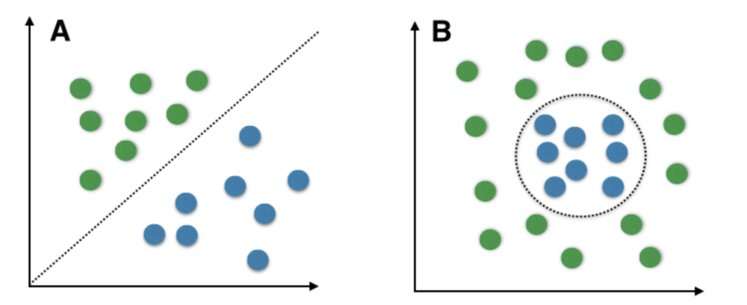
Linearly Separable Data VS Non-Linearly Separable Data
‹#›
Fig 2 : Linearly Separable Data Fig 3 : Non-Linearly Separable Data
Notes:
Optimisation of the Beer Distribution Game
‹#›

Slide 17
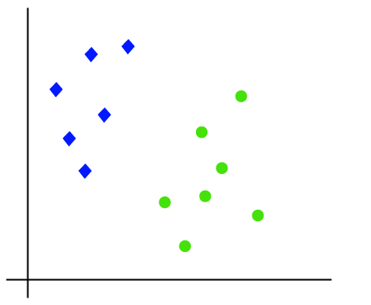
How does SVM works?
‹#›
Linear SVM: Suppose we have a dataset that has two tags (green and blue), and the dataset has two features x1 and x2. We want a classifier that can classify the pair(x1, x2) of coordinates in either green or blue. Consider the below image:
Notes:
Optimisation of the Beer Distribution Game
‹#›

Slide 18
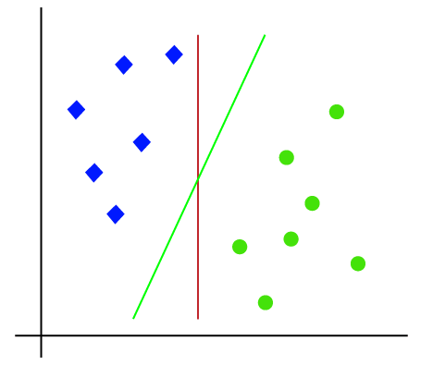
How does SVM works?
‹#›
So as it is 2-d space so by just using a straight line, we can easily separate these two classes. But there can be multiple lines that can separate these classes. Consider the below image:
Hence, the SVM algorithm helps to find the best line or decision boundary/hyperplane. SVM algorithm finds the closest point of the lines from both the classes. These points are called support vectors. The distance between the vectors and the hyperplane is called as margin. And the goal of SVM is to maximize this margin. The hyperplane with maximum margin is called the optimal hyperplane.
Notes:
Optimisation of the Beer Distribution Game
‹#›

Slide 19
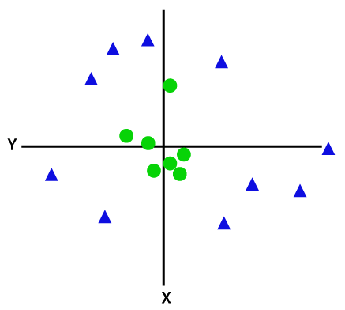

How does SVM works?
‹#›
Non-Linear SVM: For non-linear data, we cannot draw a single straight line. Consider the below image:
So to separate these data points, we need to add one more dimension. For linear data, we have used two dimensions x and y, so for non-linear data, we will add a third dimension z. It can be calculated as: (You’ll notice that’s the equation for a circle).
Notes:
Optimisation of the Beer Distribution Game
‹#›

Slide 20
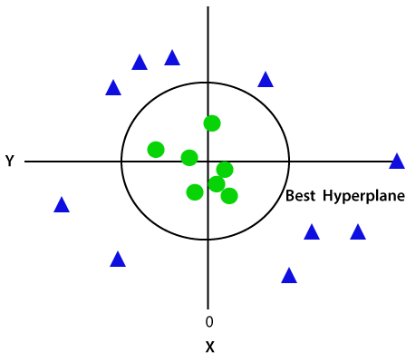
How does SVM works?
‹#›
Notes:
Optimisation of the Beer Distribution Game
‹#›

Slide 21
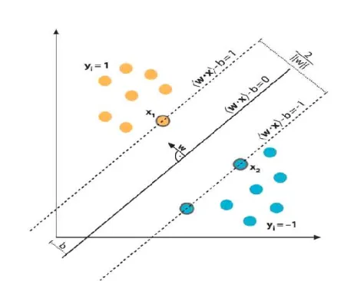
Mathematical Interpretation of Optimal Hyperplane
‹#›
Notes:
Optimisation of the Beer Distribution Game
‹#›

Slide 22
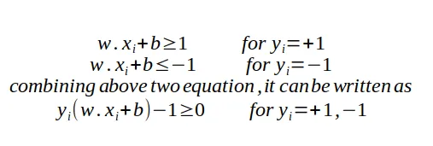
Mathematical Interpretation of Optimal Hyperplane
‹#›
we have l training examples where each example x are of D dimension and each have labels of either y=+1 or y= -1 class, and our examples are linearly separable.
From the above Fig , SVM problem can be formulated as
Notes:
Optimisation of the Beer Distribution Game
‹#›

Slide 23
The pros and cons for using SVMs
‹#›
Pros
Effective on datasets with multiple features, like financial or medical data.
Effective in cases where number of features is greater than the number of data points.
Uses a subset of training points in the decision function called support vectors which makes it memory efficient.
Different kernel functions can be specified for the decision function. You can use common kernels, but it's also possible to specify custom kernels.
Cons
If the number of features is a lot bigger than the number of data points, avoiding over-fitting when choosing kernel functions and regularization term is crucial.
SVMs don't directly provide probability estimates. Those are calculated using an expensive five-fold cross-validation.
Works best on small sample sets because of its high training time.
Notes:
Optimisation of the Beer Distribution Game
‹#›

Slide 24
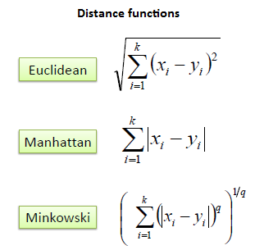
K-Nearest Neighbor(KNN) Algorithm
‹#›
K-nearest neighbors (KNN) algorithm is a type of supervised ML algorithm. It works by calculating the distance of each test observation from the K nearest neighbors of it. There are several types of distance measures techniques but we only use some of them and they are listed below:
Ireland
Virginia
Japan
California
H K/ Sing
Notes:
Optimisation of the Beer Distribution Game
‹#›

Slide 25
How does K-NN work?
‹#›
The K-NN working can be explained on the basis of the below algorithm:
Step-1: Select the number K of the neighbors
Step-2: Calculate the Euclidean distance of K number of neighbors
Step-3: Take the K nearest neighbors as per the calculated Euclidean distance.
Step-4: Among these k neighbors, count the number of the data points in each category.
Step-5: Assign the new data points to that category for which the number of the neighbor is maximum.
Step-6: Our model is ready.
Ireland
Virginia
Japan
California
H K/ Sing
Notes:
Optimisation of the Beer Distribution Game
‹#›

Slide 26
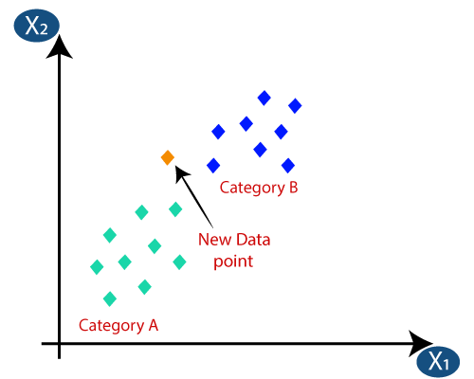
How does K-NN work?
‹#›
Suppose we have a new data point and we need to put it in the required category. Consider the below image:
Ireland
Virginia
Japan
California
H K/ Sing
Notes:
Optimisation of the Beer Distribution Game
‹#›

Slide 27
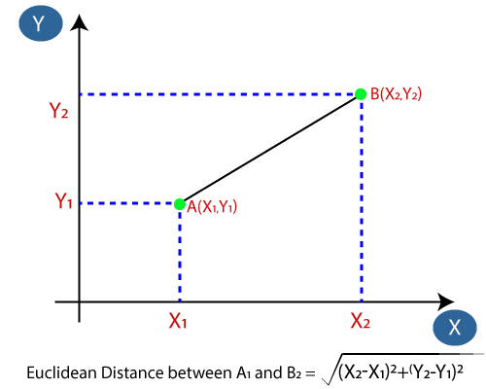
How does K-NN work?
‹#›
Firstly, we will choose the number of neighbors, so we will choose the k=5.
Next, we will calculate the Euclidean distance between the data points. The Euclidean distance is the distance between two points, which we have already studied in geometry. It can be calculated as:
Ireland
Virginia
Japan
California
H K/ Sing
Notes:
Optimisation of the Beer Distribution Game
‹#›

Slide 28
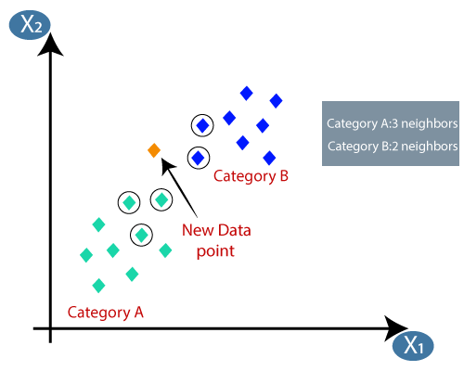
How does K-NN work?
‹#›
By calculating the Euclidean distance we got the nearest neighbors, as three nearest neighbors in category A and two nearest neighbors in category B. Consider the below image:
As we can see the 3 nearest neighbors are from category A, hence this new data point must belong to category A.
Ireland
Virginia
Japan
California
H K/ Sing
Notes:
Optimisation of the Beer Distribution Game
‹#›

Slide 29
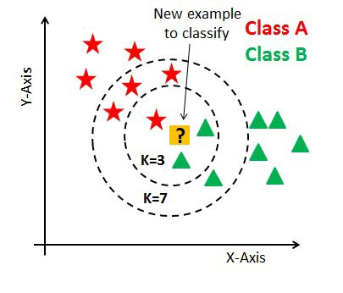
How to select the value of K in the K-NN Algorithm?
‹#›
K-value indicates the count of the nearest neighbors.
As you can verify from the above image, if we proceed with K=3, then we predict that test input belongs to class B, and if we continue with K=7, then we predict that test input belongs to class A.
Ireland
Virginia
Japan
California
H K/ Sing
Notes:
Optimisation of the Beer Distribution Game
‹#›

Slide 30
How to select the value of K in the K-NN Algorithm?
‹#›
In KNN, finding the value of k is not easy. A small value of k means that noise will have a higher influence on the result and a large value make it computationally expensive. Data scientists usually choose as an odd number if the number of classes is 2 and another simple approach to select k is set k=sqrt(n).
Ireland
Virginia
Japan
California
H K/ Sing
Notes:
Optimisation of the Beer Distribution Game
‹#›

Slide 31
How to select the value of K in the K-NN Algorithm?
‹#›
Then how to select the optimal K value?
There are no pre-defined statistical methods to find the most favorable value of K.
Initialize a random K value and start computing.
Choosing a small value of K leads to unstable decision boundaries.
The substantial K value is better for classification as it leads to smoothening the decision boundaries.
Derive a plot between error rate and K denoting values in a defined range. Then choose the K value as having a minimum error rate.
Ireland
Virginia
Japan
California
H K/ Sing
Notes:
Optimisation of the Beer Distribution Game
‹#›

Slide 32
Pros and Cons of KNN
‹#›
Pros
It is simple to implement.
It is robust to the noisy training data
It can be more effective if the training data is large.
Cons
Always needs to determine the value of K which may be complex some time.
The computation cost is high because of calculating the distance between the data points for all the training samples.
Prediction is slow in case of big N.
Ireland
Virginia
Japan
California
H K/ Sing
Notes:
Optimisation of the Beer Distribution Game
‹#›

